Slide 1

Quality Assessment

Slide 2

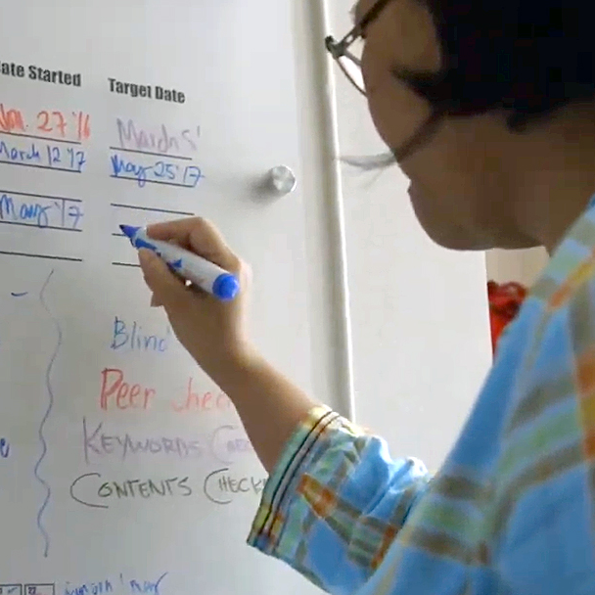
Subjective vs. Objective
Subjective |  | Objective
Changes |  | Does not change
Based on personal opinion |  | Based on fact or an agreement

Slide 3

Set the Standard
Making a quality assessment guide
Create a list of 10 good translation qualities
Define each quality
Make questions to check each quality

Slide 4
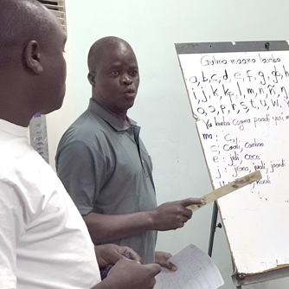
Example
Message accuracy
Is the message the same?
Is there anything extra?
Is anything missing?

Slide 5
?
Agree on what is important
Provide a standard to uphold
Why make a guide?
Checking for Scripture quality

Slide 6


